Slide 1
An adaptive decision based kriging interpolation algorithm for the removal of high density salt and pepper noise in images

Slide 2
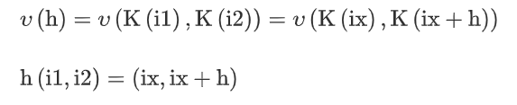

Kriging
Kriging is the most powerful statistical interpolation method. This interpolation is linear, since the interpolated values are weighted linear combinations of available uncorrupted pixels in a closed neighborhood

Slide 3

Interpolation
Ď is the interpolated value
D is the set of original samples observed
W is the weights obtained using Semi variance
“L” refers to total number of samples observed.

Slide 4
Semivariogram
Non Noisy Pixel | Z | 40 | 39 | 51
Y coordinate | m | 0 | 1 | 1
X Coordinate | n | 1 | −1 | 1
Y/X | -1 | 0 | 1
-1 | 0 | 255 | 255
0 | 0 | 0 | 40
1 | 39 | 255 | 51

Slide 5
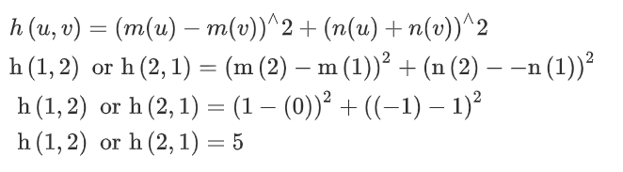
H-matrix
h - Matrix | Non Noisy Pixel | 40 | 39 | 51
 | 40 | 0 | 5 | 1
 | 39 | 5 | 0 | 4
 | 51 | 1 | 4 | 0
Sum (S) |  | 6 | 9 | 5
Divide by 2*I (wts) Sum: |  | 1 | 1.5 | 0.833 3.33

Slide 6

Calculation of interpolation
The formulae used for estimating the pixel at (0,0) using Kriging interpolation is given by the equation
O(x,y) = (40x1+1.5x39+0.833x51)/(3.33)
= 42

Slide 7
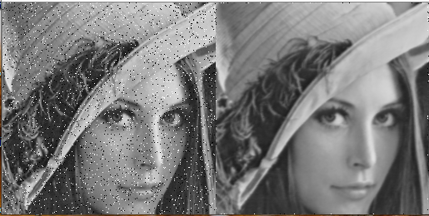
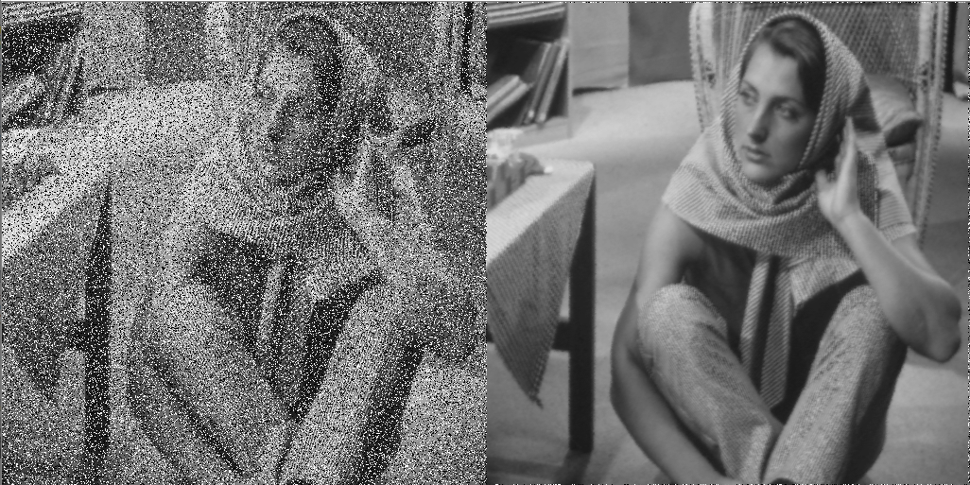

Slide 8
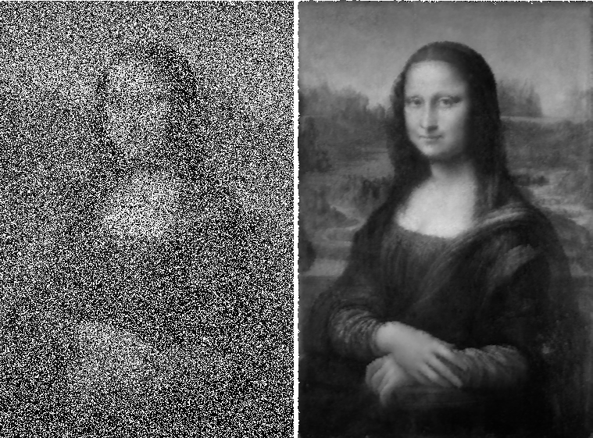

Slide 9
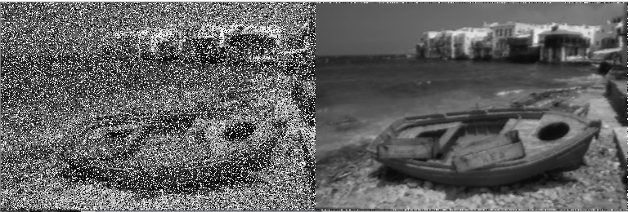
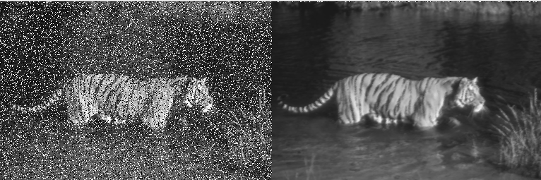

Slide 10
References
https://www.sciencedirect.com/science/article/pii/S0045790617315409#bib0003

